Slide 1
Use Case Concept
Use case is one way of representing system functionality.
Use case refers to
  A system’s behavior (functionality)
  A set of activities that produce some output.
Think in terms of main processes happening in the system.
In the simplest form, use case is a list of functions for a user;
Example →
Use verbs for naming use cases.
9.351 Systems Analysis & Design
Use Case

Slide 2
Actor Concept
Actor is someone or something interacting with use case.
Similar to the concept of user, although the user can appear
as different actors (e.g., a prof. can be instructor and researcher).
Actor triggers use case.
Each Actor must be linked to a use case, while some use cases may not be linked to actors.
Actor—Use Case: Actor has responsibility toward the system (inputs), and Actor have expectations from the system (outputs).
Careful: Lines between Actors and Use Cases are NOT data flows!
9.351 Systems Analysis & Design
Use Case

Slide 3
Use Case Symbols
Use Case
        Actor
Boundary
      Connection
Include relationship
Extend relationship
Note: different names
used in different software
<<include>>
<<extend>>
9.351 Systems Analysis & Design
Use Case

Slide 4
Use Case Diagram
A diagram representing system’s behavior—use cases and actors.
Provides a global look of a system – it’s basic functionality
(use cases) and environment (actors).
Useful for early structuring of requirements; iterative revisions.
May be understood by users on the intuitive level.
9.351 Systems Analysis & Design
Use Case

Slide 5
Extend Relationship between Use Cases
Extend relationship –
linking an optional use case to a standard use case.
Example: Register Course (standard use case) may have
Register for Special Class (extend use case).
Standard use case can execute without the extend case.
→ loose coupling
See next slide →
9.351 Systems Analysis & Design
Use Case

Slide 6
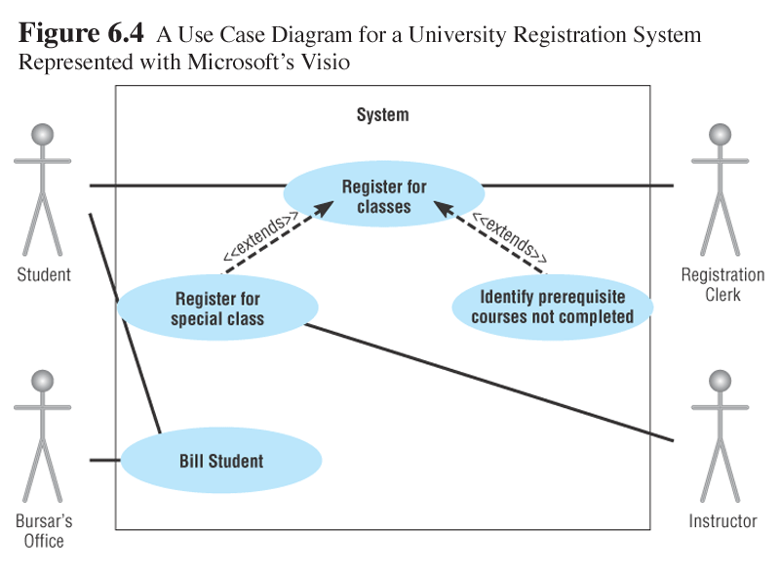
Extend Relationship Between Use Cases
Careful: Arrows between Use Cases are NOT data flows!
9.351 Systems Analysis & Design
Use Case

Slide 7
Include Relationship Between Use Cases
Include relationship –
a standard case linked to an mandatory use case.
Example: to Authorize Car Loan (standard use case), a clerk must run Check Client’s Credit History (include use case).
→ tight coupling
Standard use case can NOT execute without the include case.
See next slide →
9.351 Systems Analysis & Design
Use Case

Slide 8
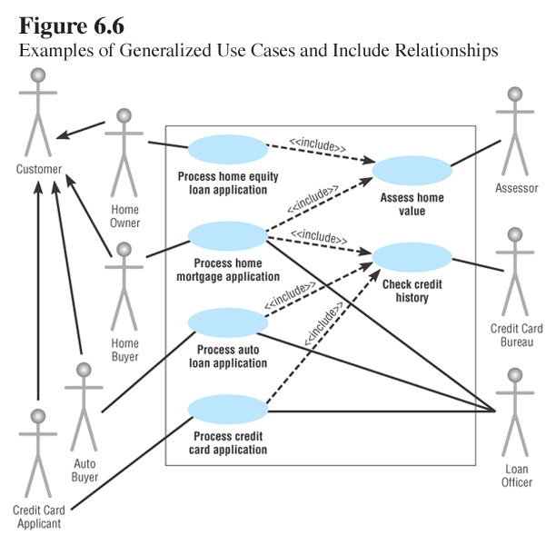
Include Relationship Between Use Cases
Careful: Arrows between Use Cases are NOT data flows!
9.351 Systems Analysis & Design
Use Case

Slide 9
Use Case Description
Use cases start with a textual description – some content
similar to use case diagrams, some new details included.
Some important details to show:
- Name of use case
- Objective
- Level (high, mid, low)
- Actor
- Interactions between use case and actor
(see Figure 6-4 and textual description on p. 188)
9.351 Systems Analysis & Design
Use Case

